Slide 1
Lockdown learning

Slide 2
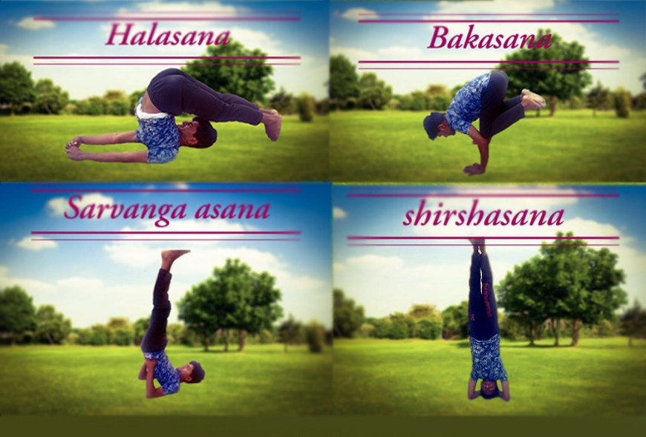
Yoga

Slide 3
Exercise
Pushup
Skipping
Pull Ups
Boxings

Slide 4
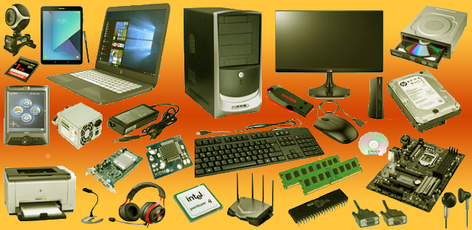
Computer hardware

Slide 5

Computer Software

Slide 6
Mobile Repairing
PCB (printed Circuit Board)
Jack
Sim
Camera
screen
Usb cable
Soldering

Slide 7
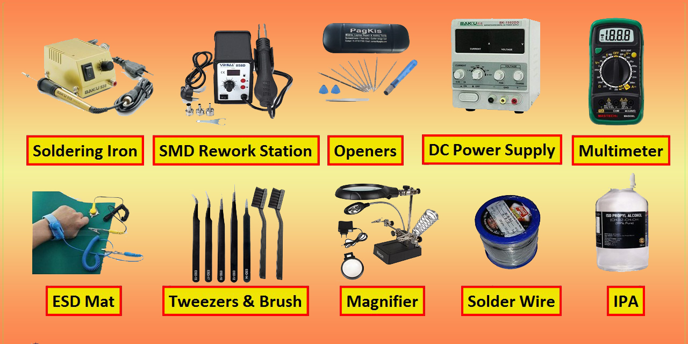
Mobile Repairing

Slide 8

HTML & CSS
Youtube video
Background colour
Svg insert
Animation
Text effect
Crousel

Slide 9
Networking
Addressing
Dns server
Dhcp server
Networking Commands
Osi model 7 layer
Tcp model

Slide 10
Science Concept
Light concept
Electrogmagnetic spectrum
Sound
Vector

Slide 11

Telecommunication
Mobile Station (MS)
Subscriber identification Module (SIM)
Base Transiver Station (BTS)
Base Station Controller (BSC)
Mobile Switching Centre (MSC)
1G, 2G, 3G, 4G, 5G architecture

Slide 12

Adobe
Photoshop
Illustrator
Premium Pro
Dreamweaver
Indesign
Animate
Audition

Slide 13

Graphic Designing

Slide 14





Slide 15
Thank you

Slide 16
Video Advertisement OF a Product

Slide 17
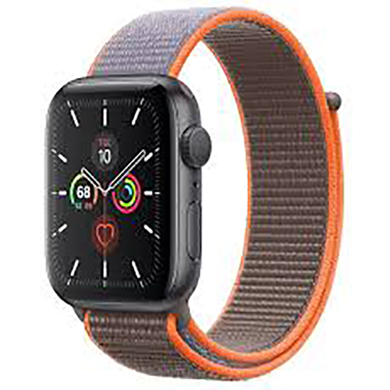
Product Tagline
WE never wast time
WE keep it.

